Slide 1
Understanding Cyber Security and Safety Perceptions for Digital Payments and E-Services :
EPABA Batch05 Capstone Project :
Group#8 : eShield

Slide 2
Project Proposal : Group # 8 : Group Name: eShield
Introduction
This study is a part of Capstone Project for EPABA Batch 05 and it explores the factors influencing cyber security during online transactions related to digital payments, e-Services and related safety perceptions among consumers. By analyzing these factors, we can gain insights into patterns of adoption of digital payments and e-services, its associations with demographic variables and challenges for adoption of digital payments and other e-services.
Project Team
Chintal Joshi | Questionnaire Framing, Data Collection, Data Pre-Processing, Noise Reduction, Report Writing
Rajiv Trivedi | Data Collection Strategies, Linear Regression, Report Writing
Hardik Raval | Linear Regression, Inference, Report Writing

Slide 3
Project Proposal
Project Objective
Determine customer preferences for utilising e-services for various sectors including digital payments, online purchases and online learning platforms
Understanding customer’s perception of effectiveness of AI tools like Chatbot, ChatGPT for resolving their queries and understanding loss of privacy during online transactions
Assess perceived safety concerns and cyber security threats including but not limited to digital authentication like FaceID, Soft Keyboard, Pin, Biometrics
Explore relationships between demographics and adoption of e-services
Analyze demographic influence on safety perceptions
Understanding counter-measures by Government and private organisations to combat cyber security threat

Slide 4
Project Proposal
Project Methodology
Design a survey to collect data on e-services usage during digital payments, online purchases, online learning platforms and demographic data of respondents such as sex, age, profession, etc.
Apply data pre-processing: normalize variables, remove noise, and ensure data integrity
Explanatory variables: sex, age, profession , type of e-services, extent of cyber security threat, frequency of transactions, merchant type
Response variables: using of online services (Yes/No), safety perception (Likert scale)
Analyze using simple linear regression: relate age, transaction data to digital payment adoption likelihood
Employ inferential statistics (chi-square tests, t-tests) for relationships between other variables
Regression analysis for demographic impact on adoption and safety perception

Slide 5
Project Proposal
Project Inferences
Understand safety perception variation by age groups
Uncover online services usage patterns (payment, purchases, learning)
Control measures against cyber security threat
Usage of advance technology for safe online transactions
Expected Outcomes
Insights into online transaction adoption factors and safety perceptions of users
Design strategies for e-services providers, network protecting tools and software providers, policymakers, and businesses
Data Collection and Confidentiality
Survey distributed with privacy and security considerations
Voluntary participation with informed consent
Data anonymized and aggregated for confidentiality

Slide 6
Data Collection Plan
Data Collection Through Google Form ( Link is shared below)
https://forms.gle/eidJ1KNXuTGur3NB9
Sample Size : > 100
Target Sample : Students, Working Professionals, House makers , Senior Citizens

Slide 7
Project Time Plan
Data Collection : By 5th Nov
Review and Cleaning of Data: By 7th Nov
Data Analysis : By 10th Nov
Review of Results and Correcting Analysis : By 20th Nov
Final Report and Presentation : By 24th Nov

Slide 8
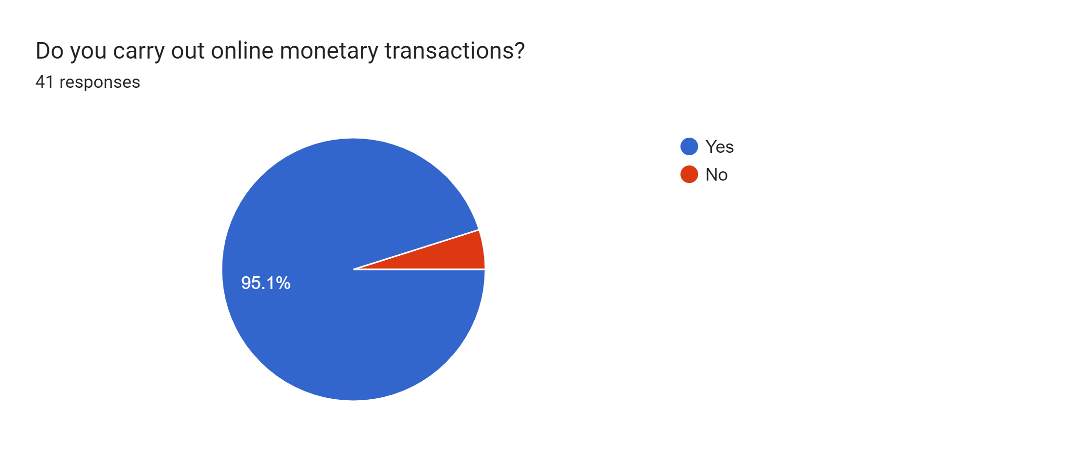
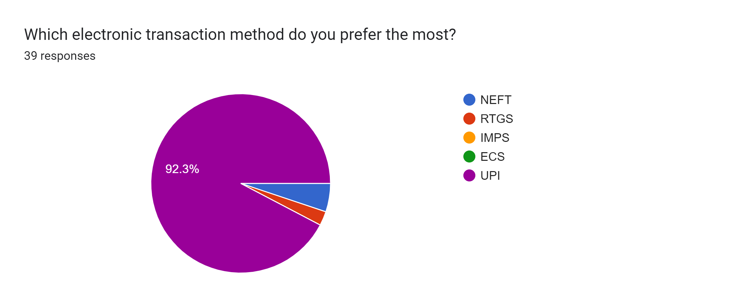

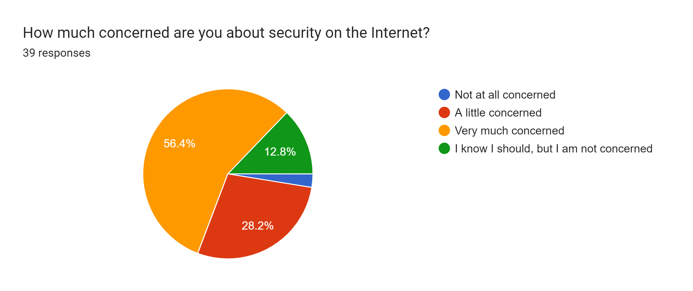
Snapshot of Responses Received

Slide 9
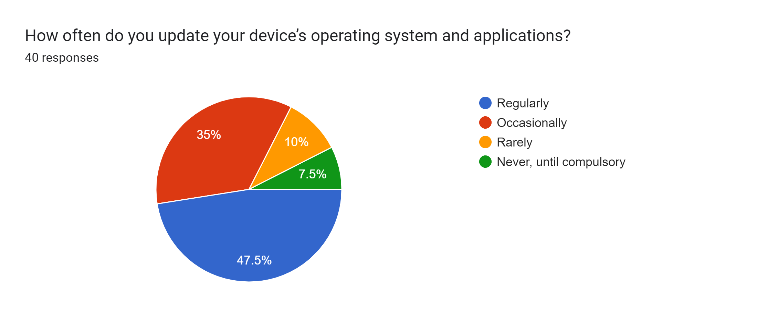
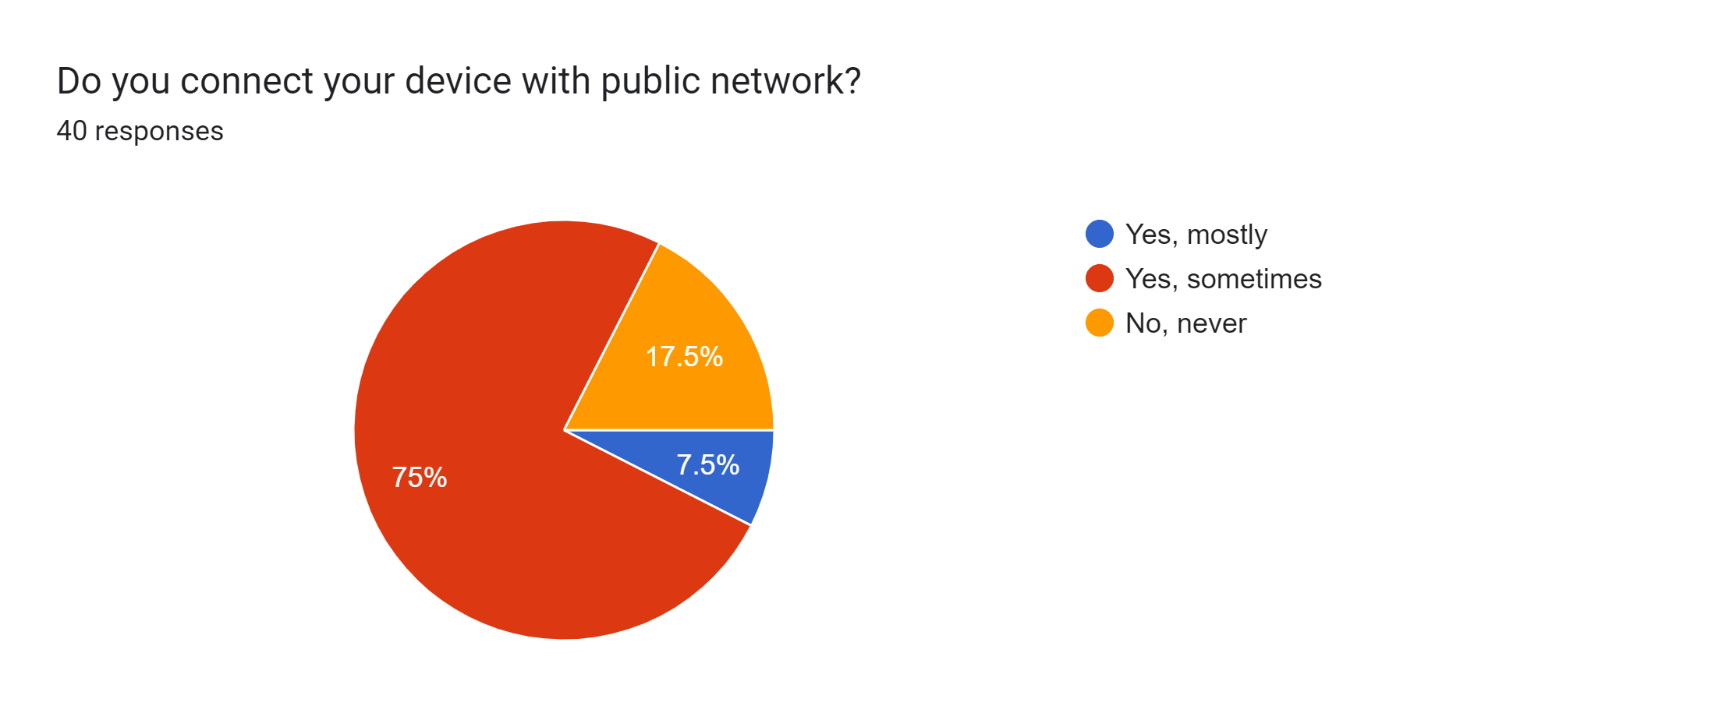
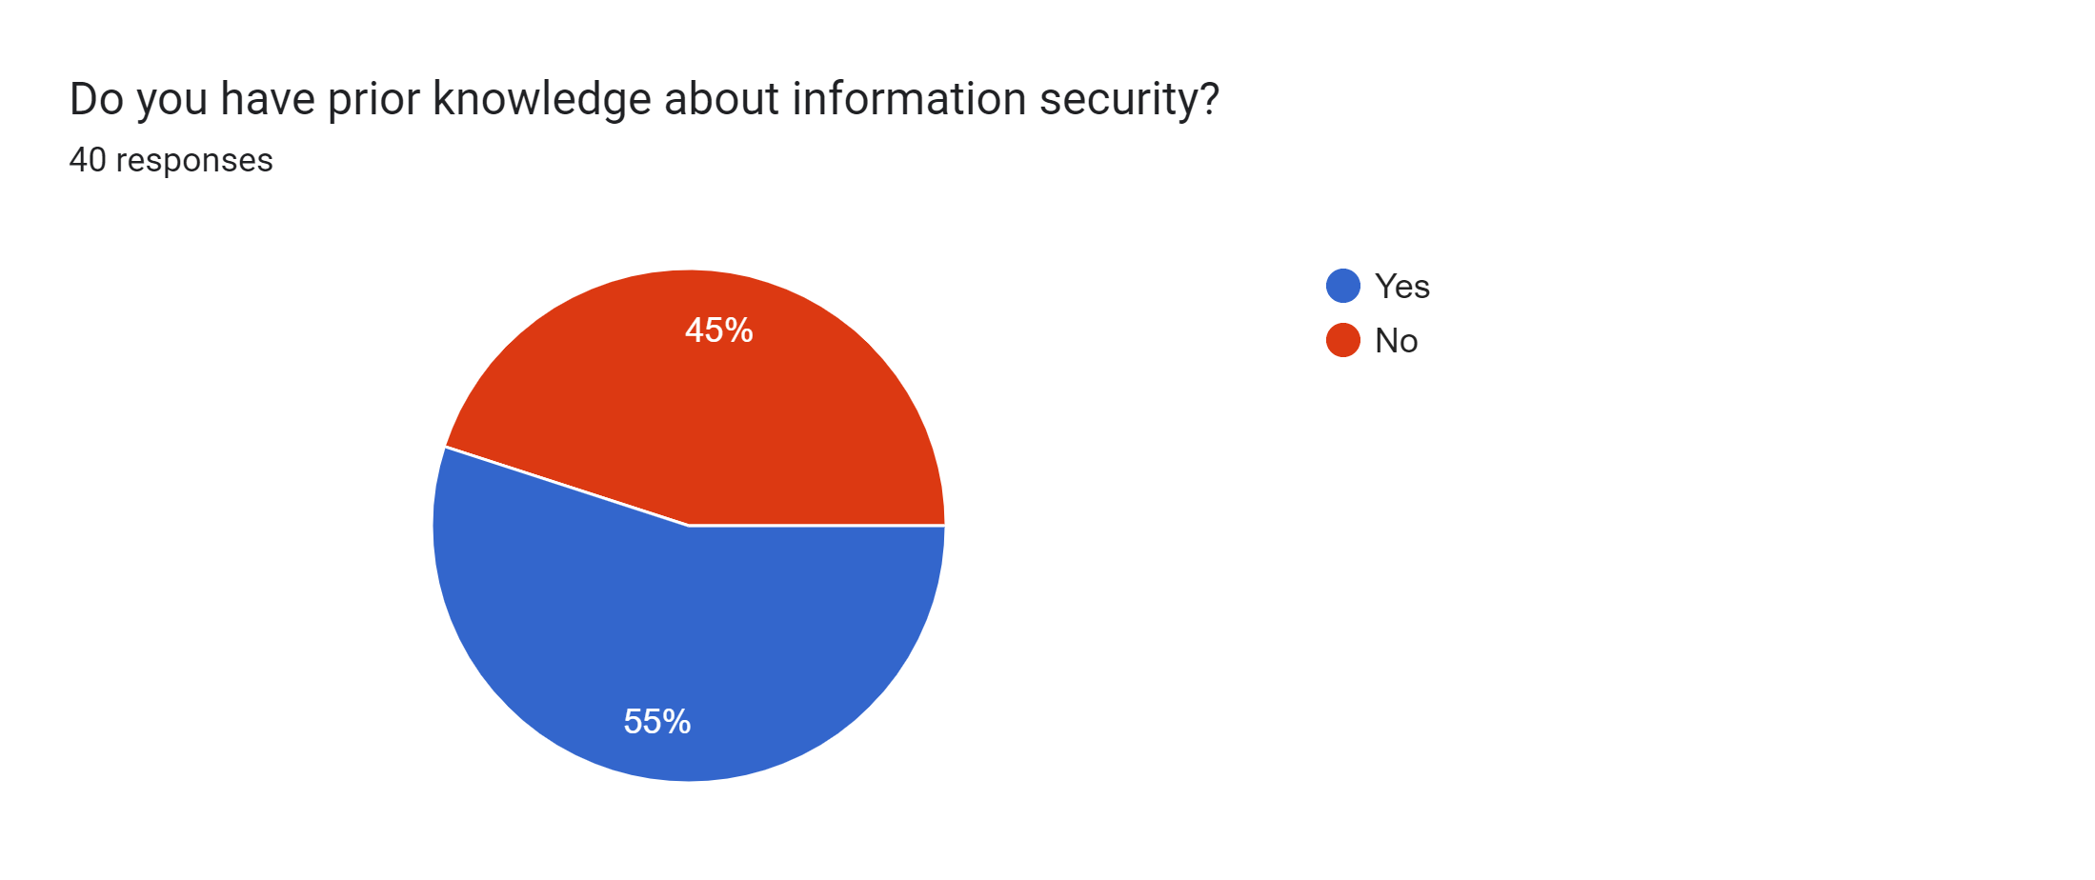
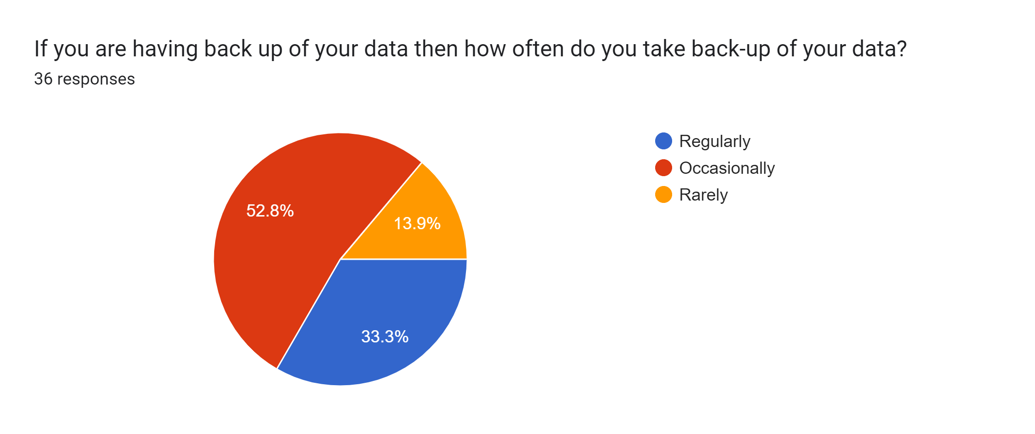
Snapshot of Responses Received

Slide 10

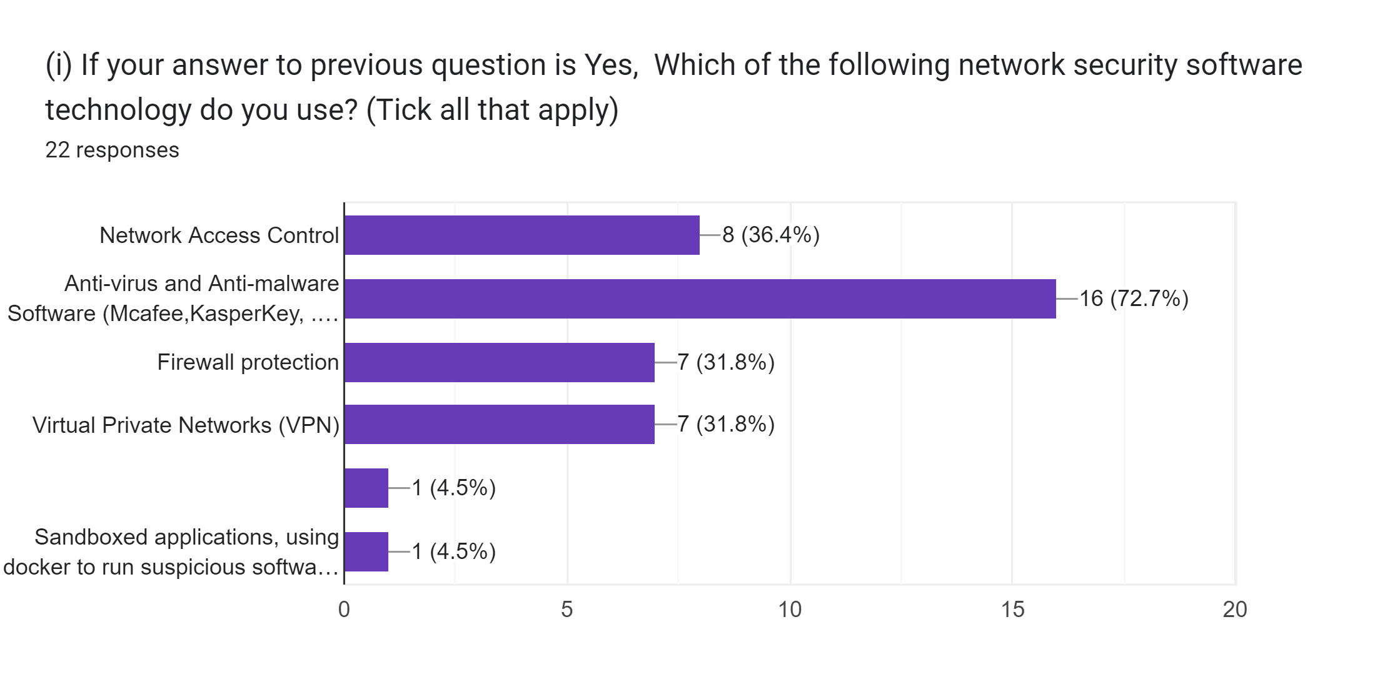
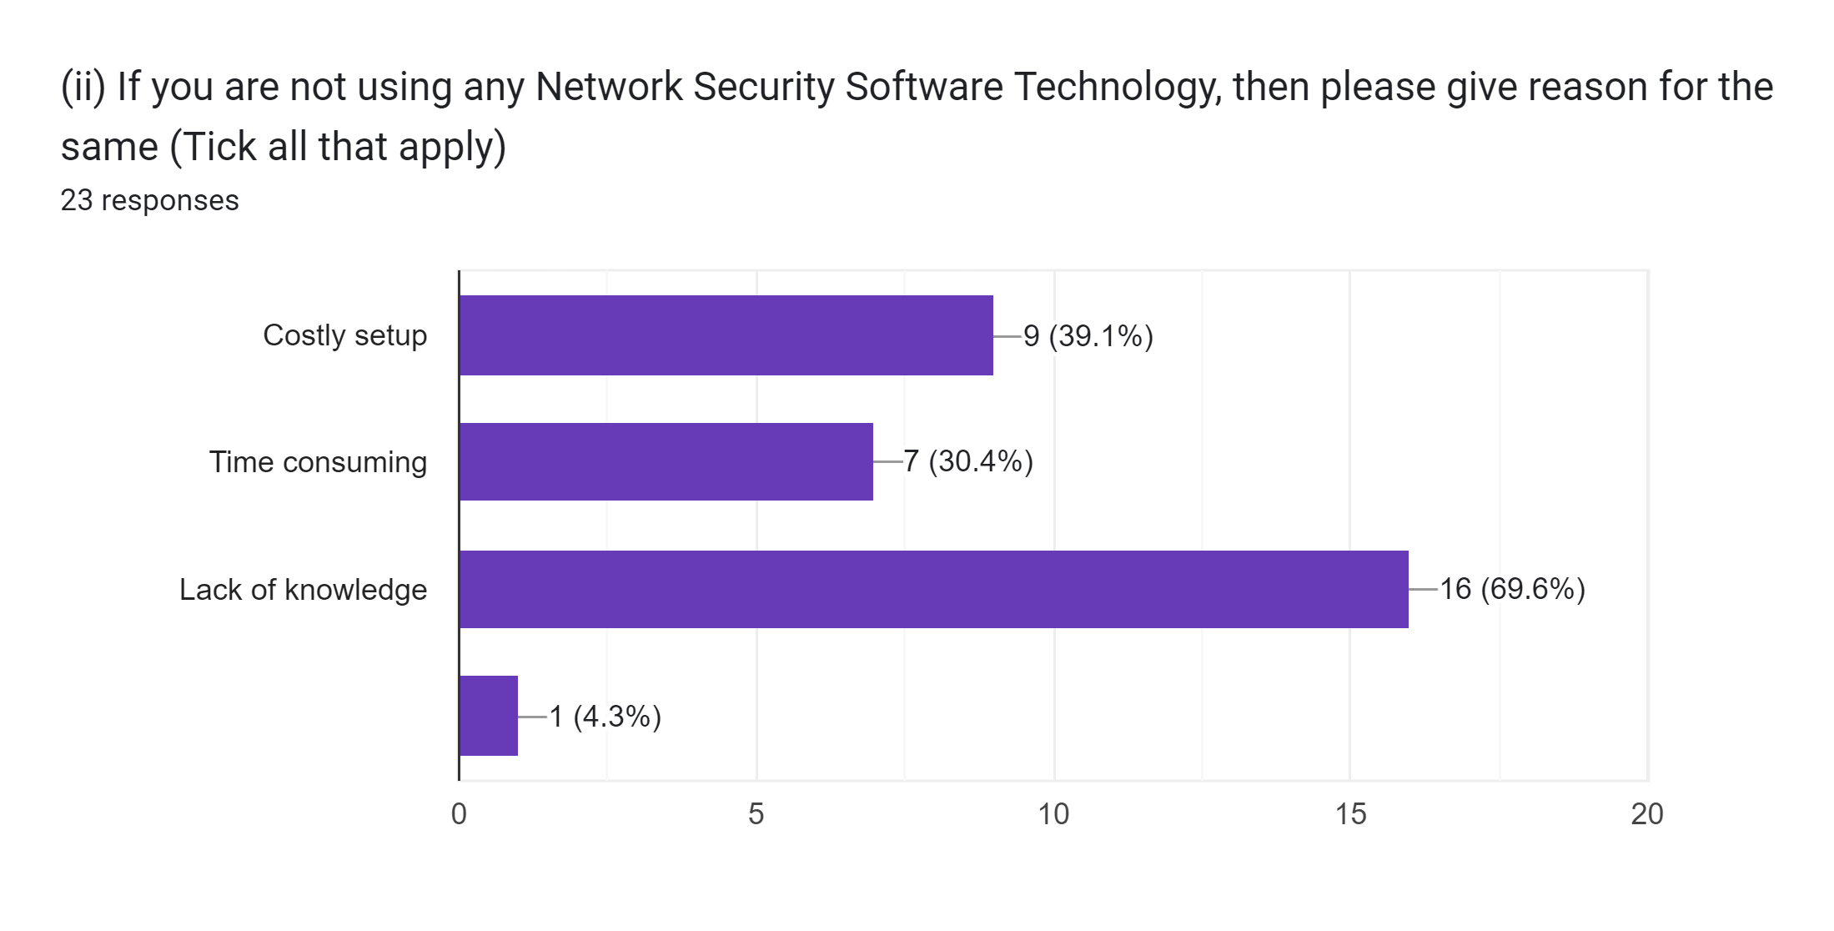
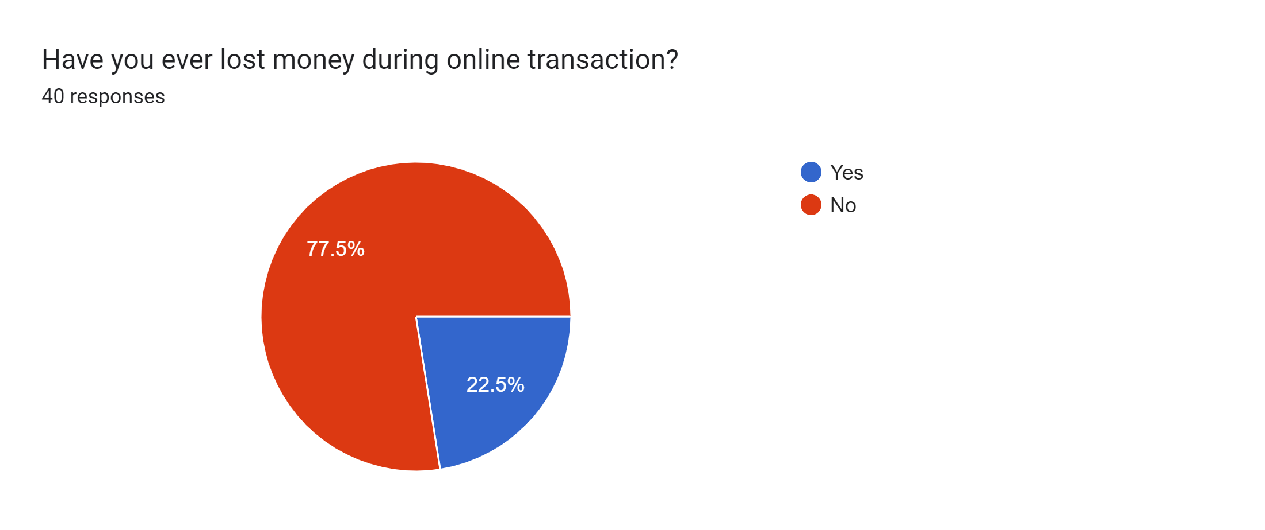
Snapshot of Responses Received

Slide 11
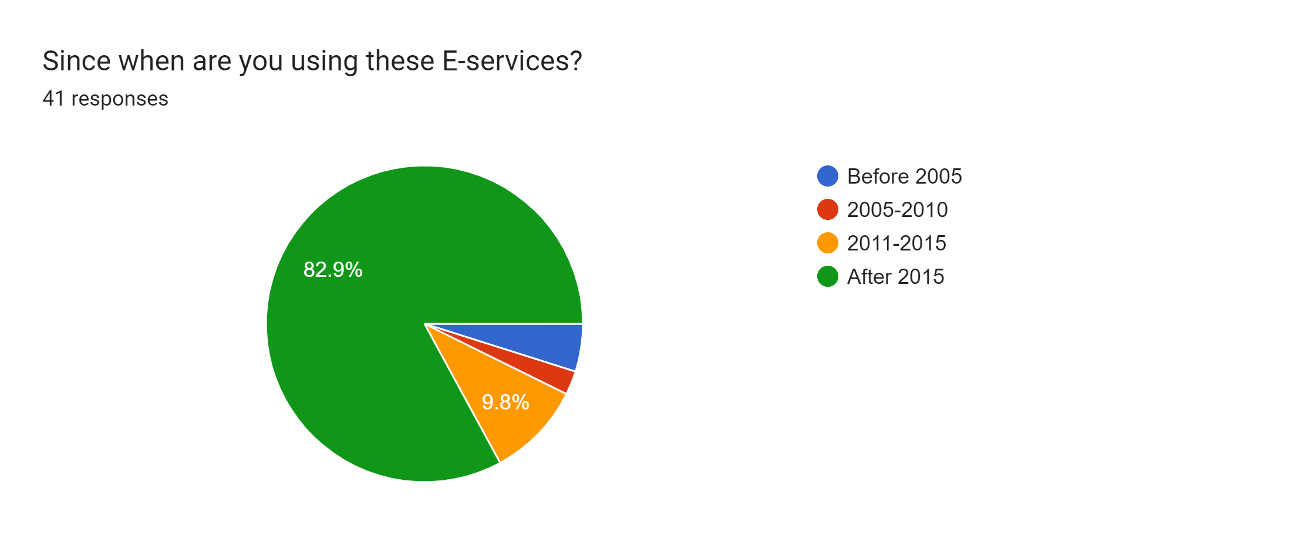
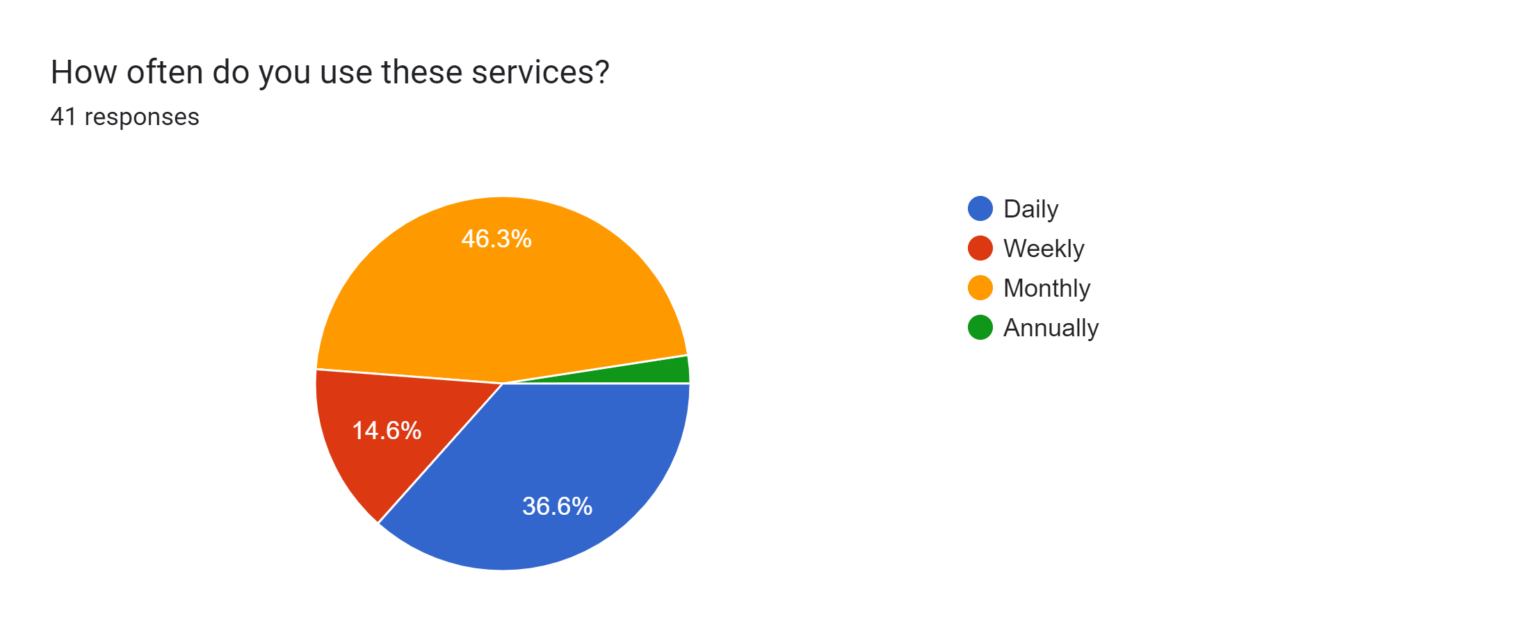
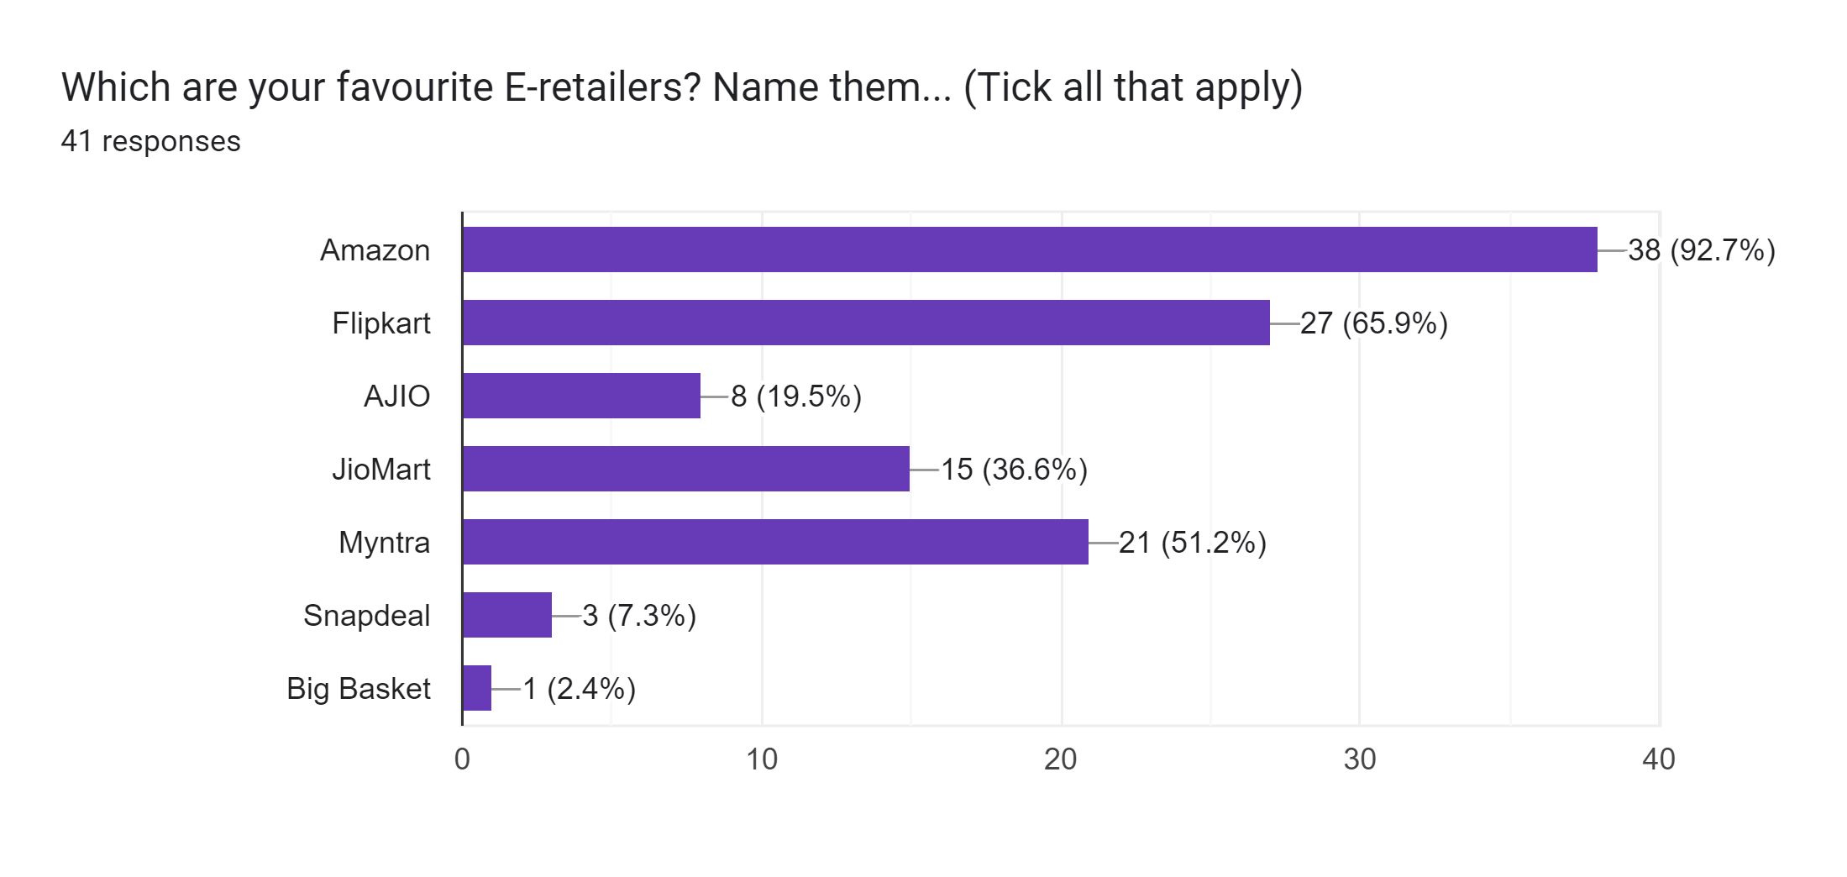
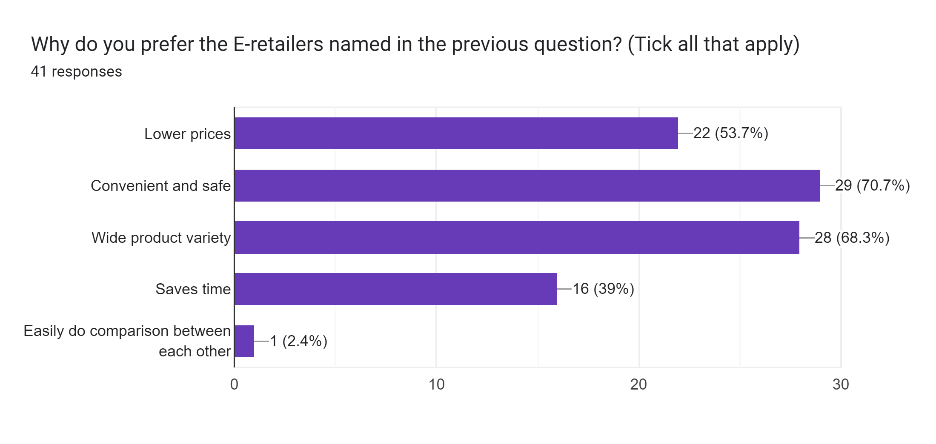
Snapshot of Responses Received

Slide 12
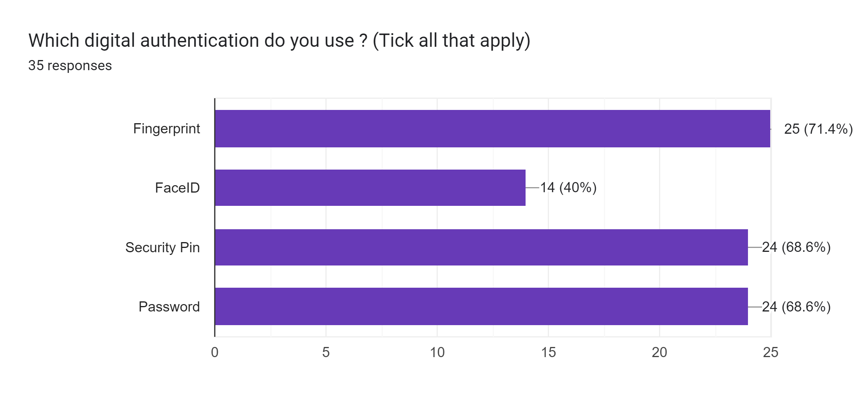
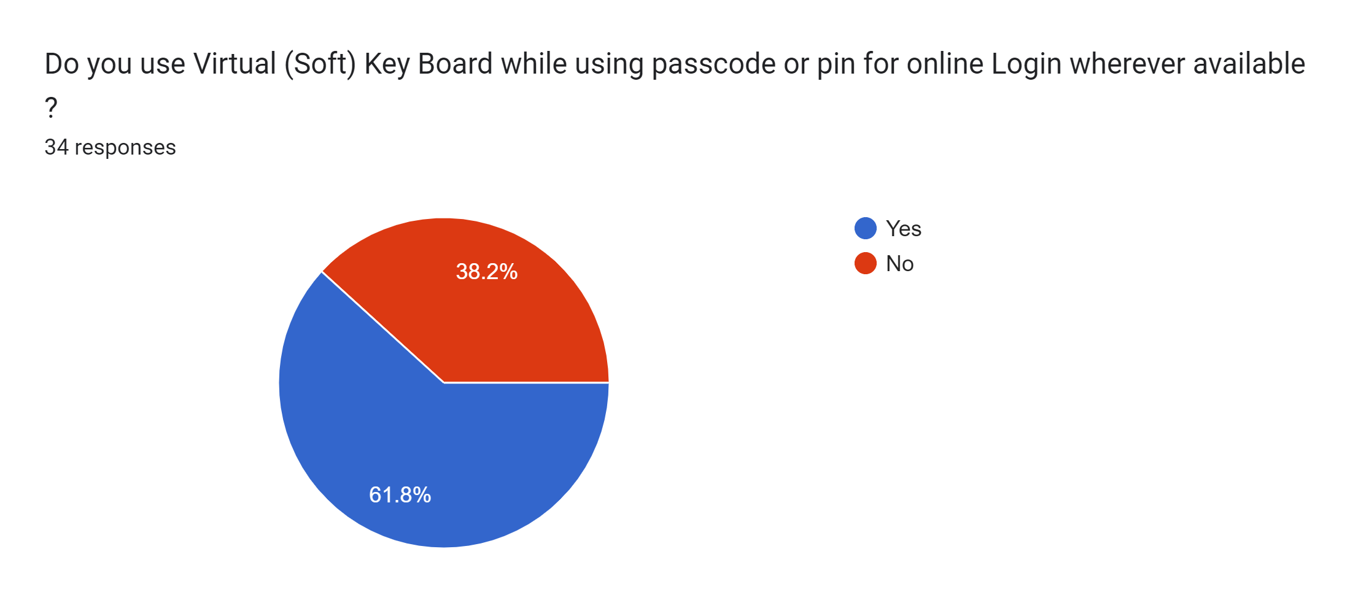

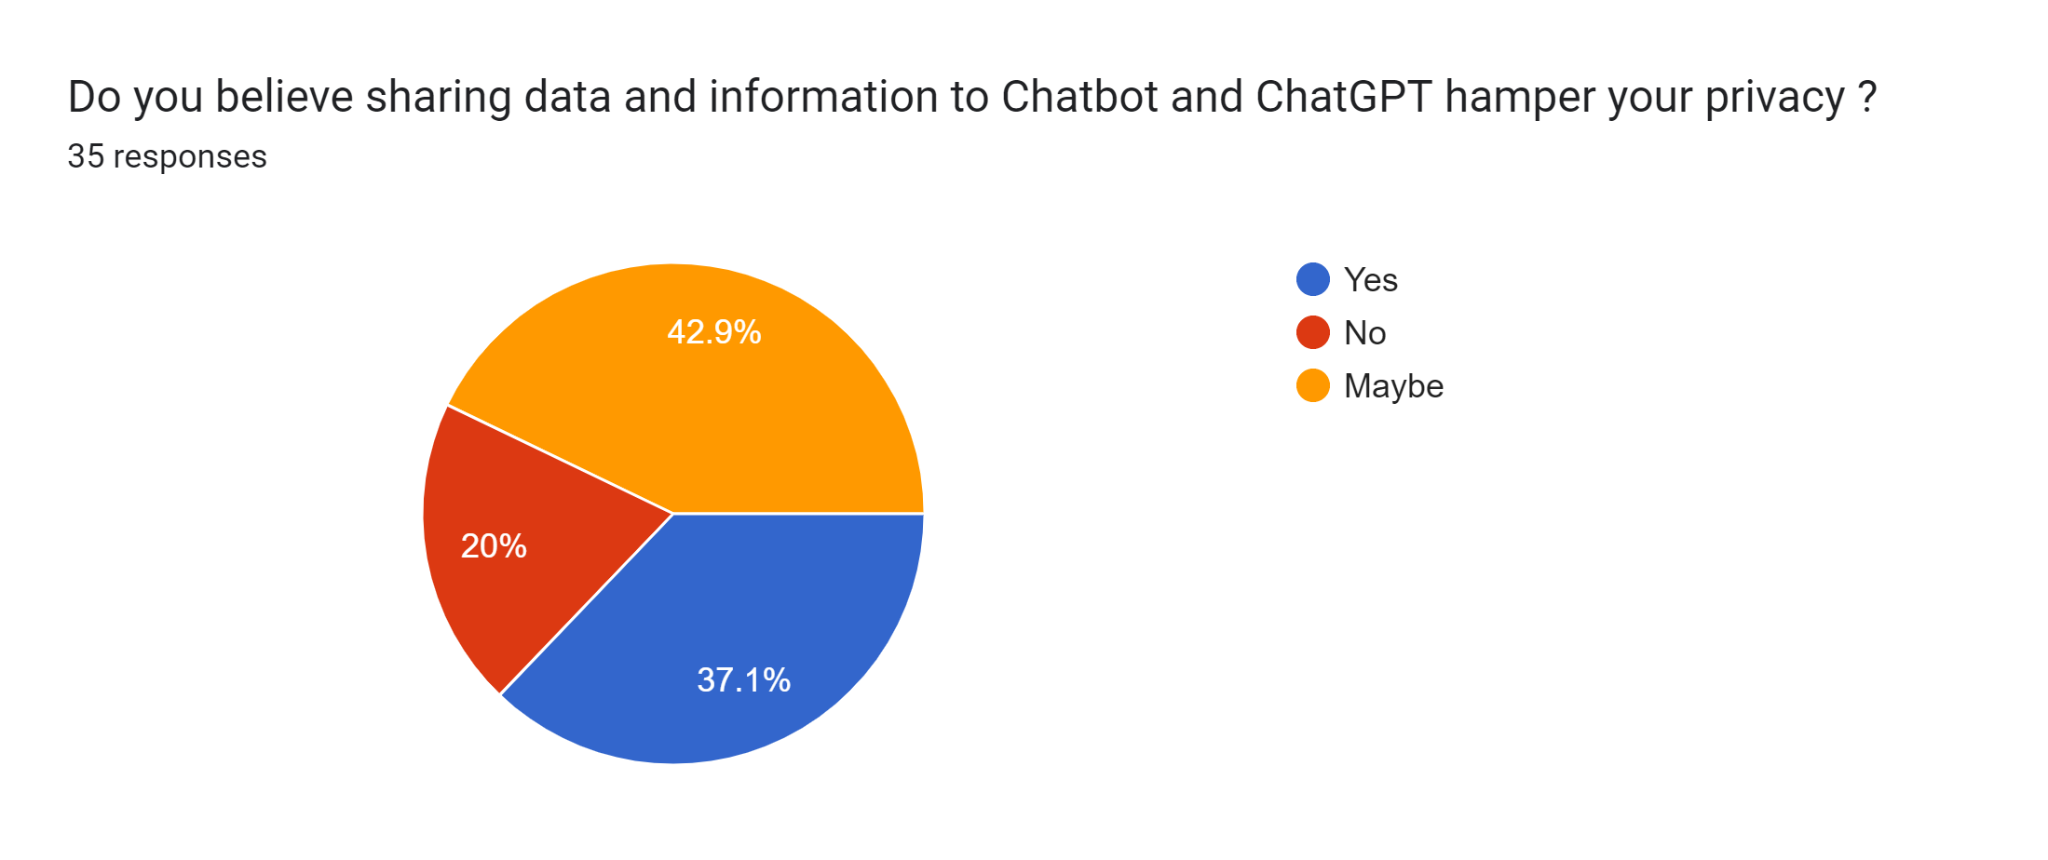
Snapshot of Responses Received

Slide 13
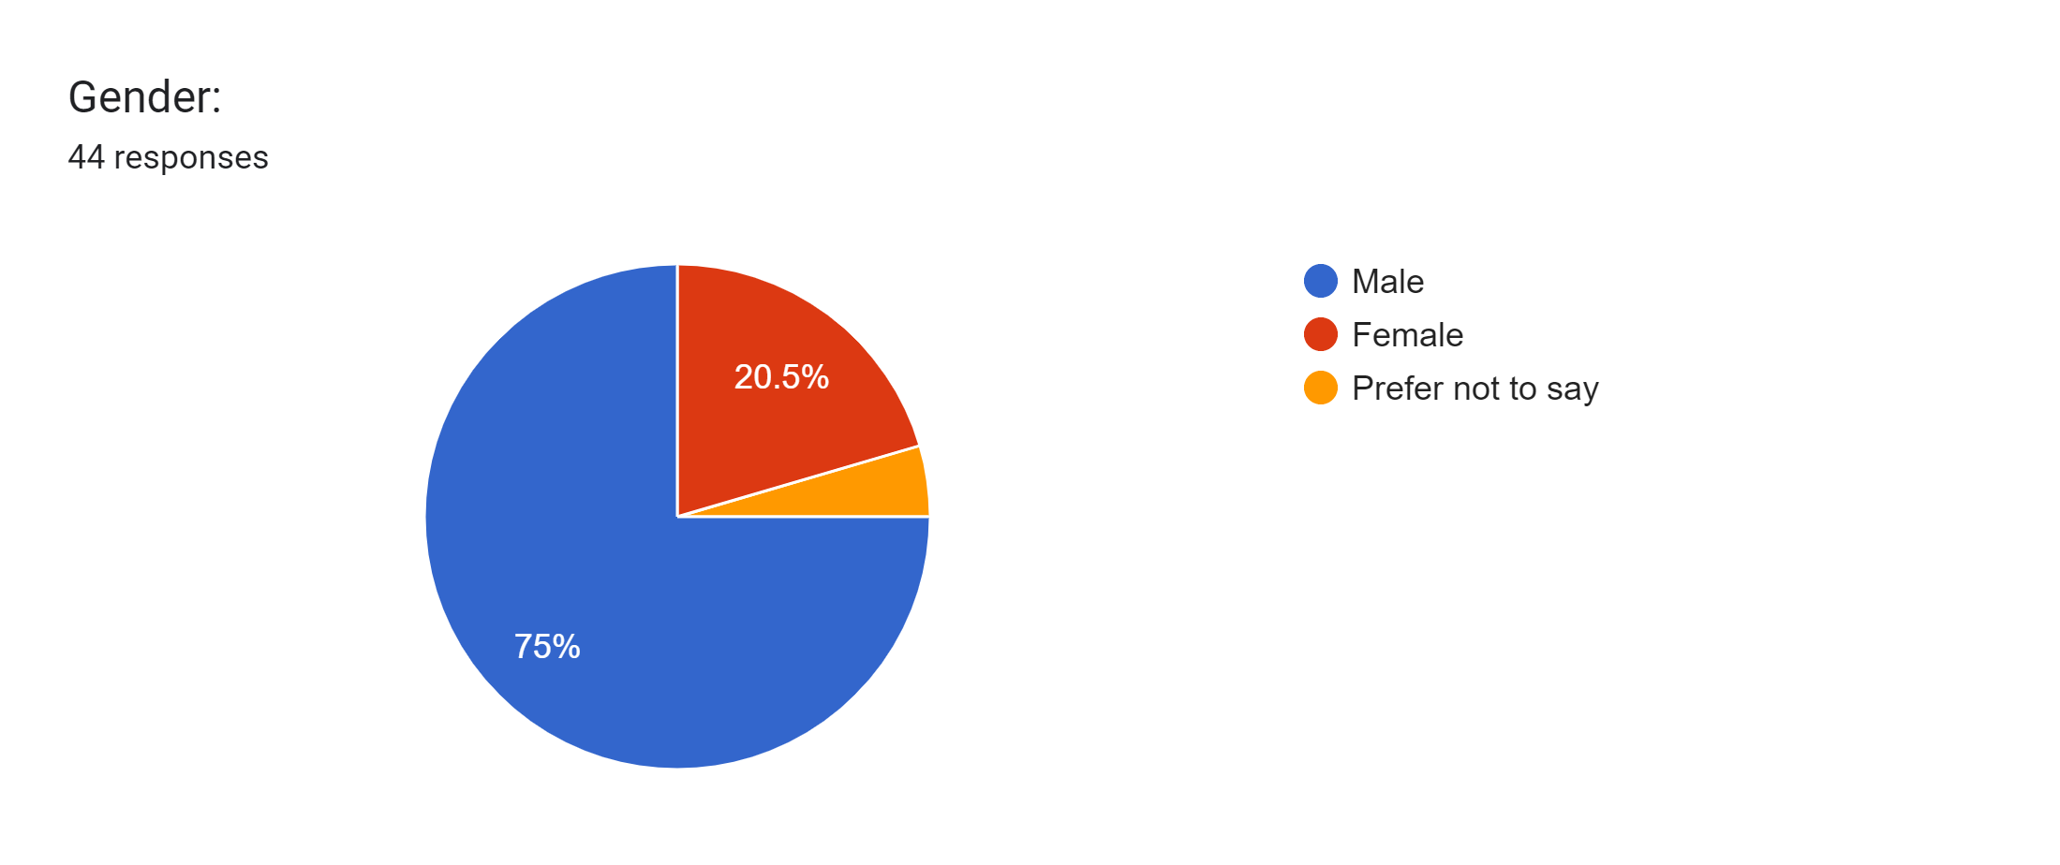
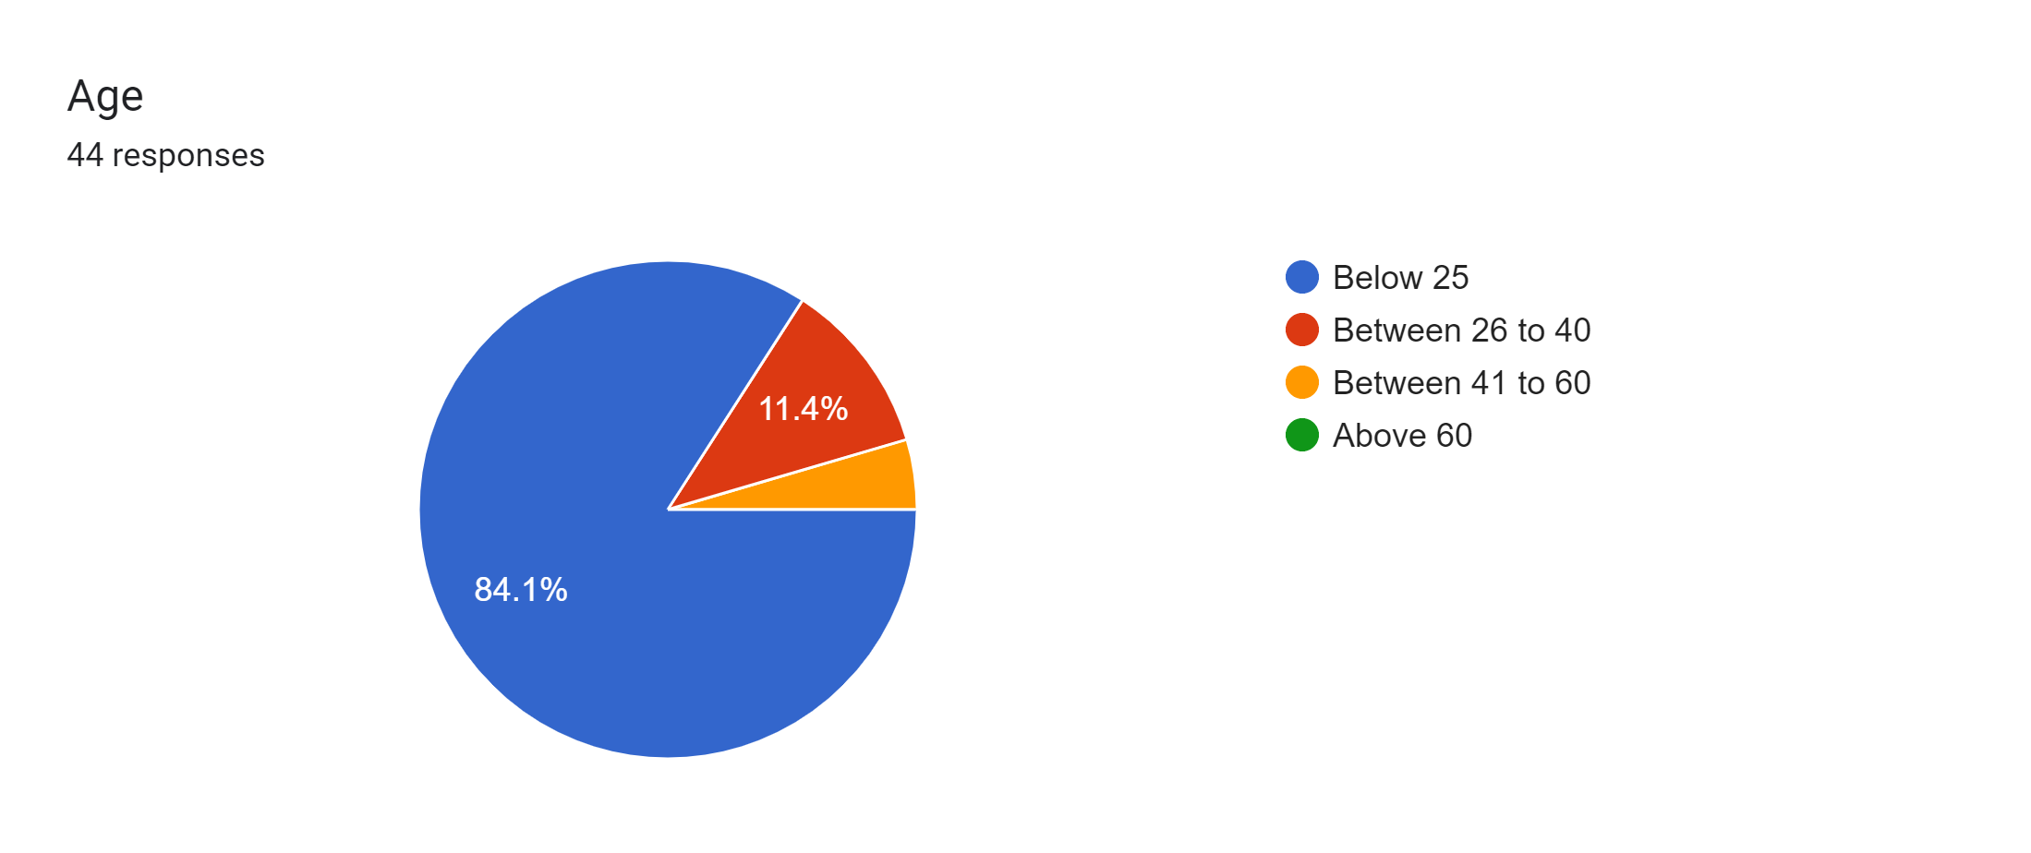
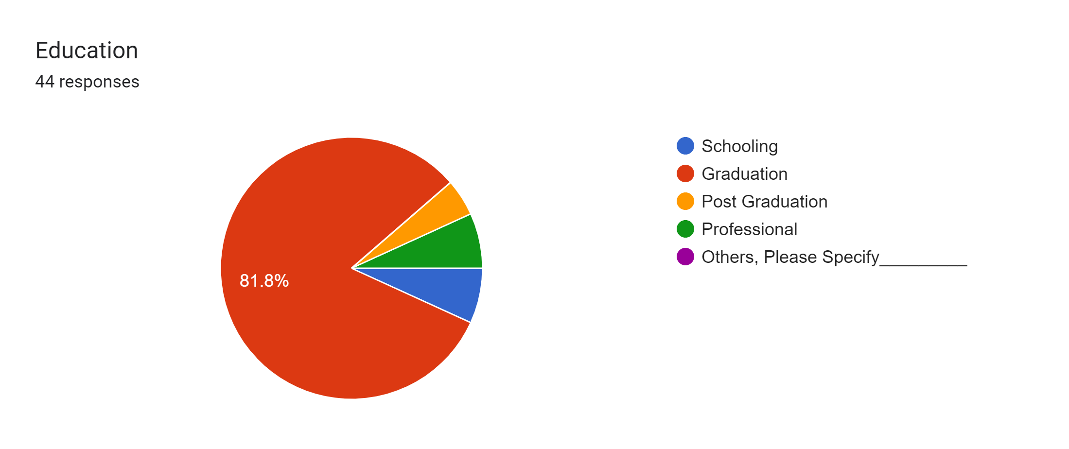
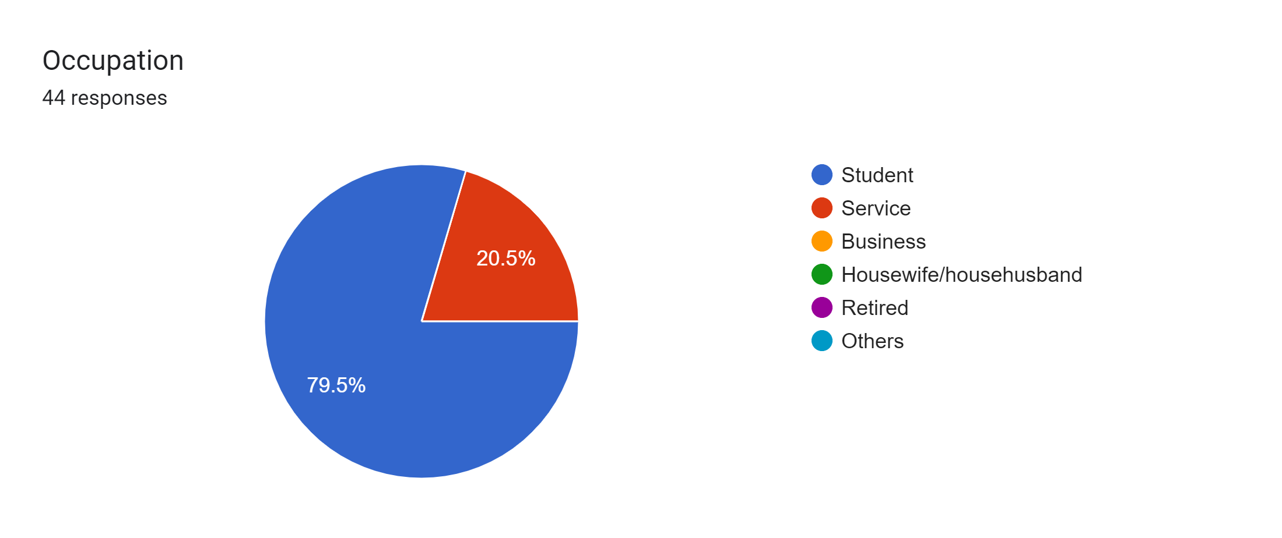
Snapshot of Responses Received

Slide 14
Variables
Independent Variables: Explanatory Variables: Predictor Variables:
Operating System Update
Public Network Connection
Knowledge
Back up of Data
Network Security Software usage
Frequency of Software update
Loss of Money during Transaction
Two-Factor Authentication
Browsing through HTTPs websites
Awareness about third party cookies
Cyber Fraud experience
Digital Authentication Method
Passcode entry Method
Dependent Variable :Response Variable:
Cyber Security Risk Perceived :> Logistics Regression
Who lost Money ? : > Probability Analysis
Which Electronic Transaction ? :> Graphical Representation
AI Technology Help ? :> Graphical Representation

Slide 15
Proposed Analysis Method and Tools
Analysis Methods:
Multiple Linear Regression
Logistics Regression
Probability Distribution
Tools :
R & Python Programming
Analysis and Creating Charts
Tableu
Graphical Representation of Data
Creating Dash Board

Slide 16
Queries :
How Many Dependent Variables we should Analyse ?
Is Sample size adequate ?

Slide 17
Thank You

